Slide 1
Hey you! Yes.Yooou. This will be a lot more fun if you clone my repo: https://github.com/afhaque/Access-Inequality Then run the command: `pip install –r requirements.txt` Oh! And get to know the person next to you please!

Slide 2
Mapping Inequalities with Python, Pandas, and Places
Open Camps!
Trilogy Education Services
| November 18, 2017

Slide 3
Outline
About Me
Telling Stories With Data
City Deserts
Framing the Approach
Building the Code
Demo Time!

Slide 4
About Me

Slide 5


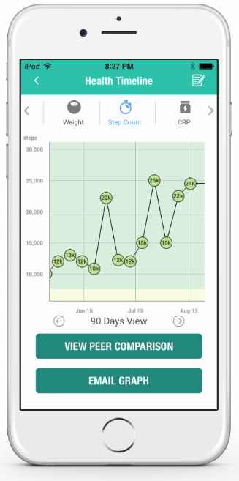
About Me
Ahmed Haque
Senior Vice President of Academics at Trilogy Education Services
Co-Architect of the Trilogy Coding and Data Science Bootcamps
Adjunct Instructor at Rutgers University
PhD Candidate in Bioengineering from Rice University
Focused on Web Connected Medical Devices in Blood-Based Diagnostics

Slide 6
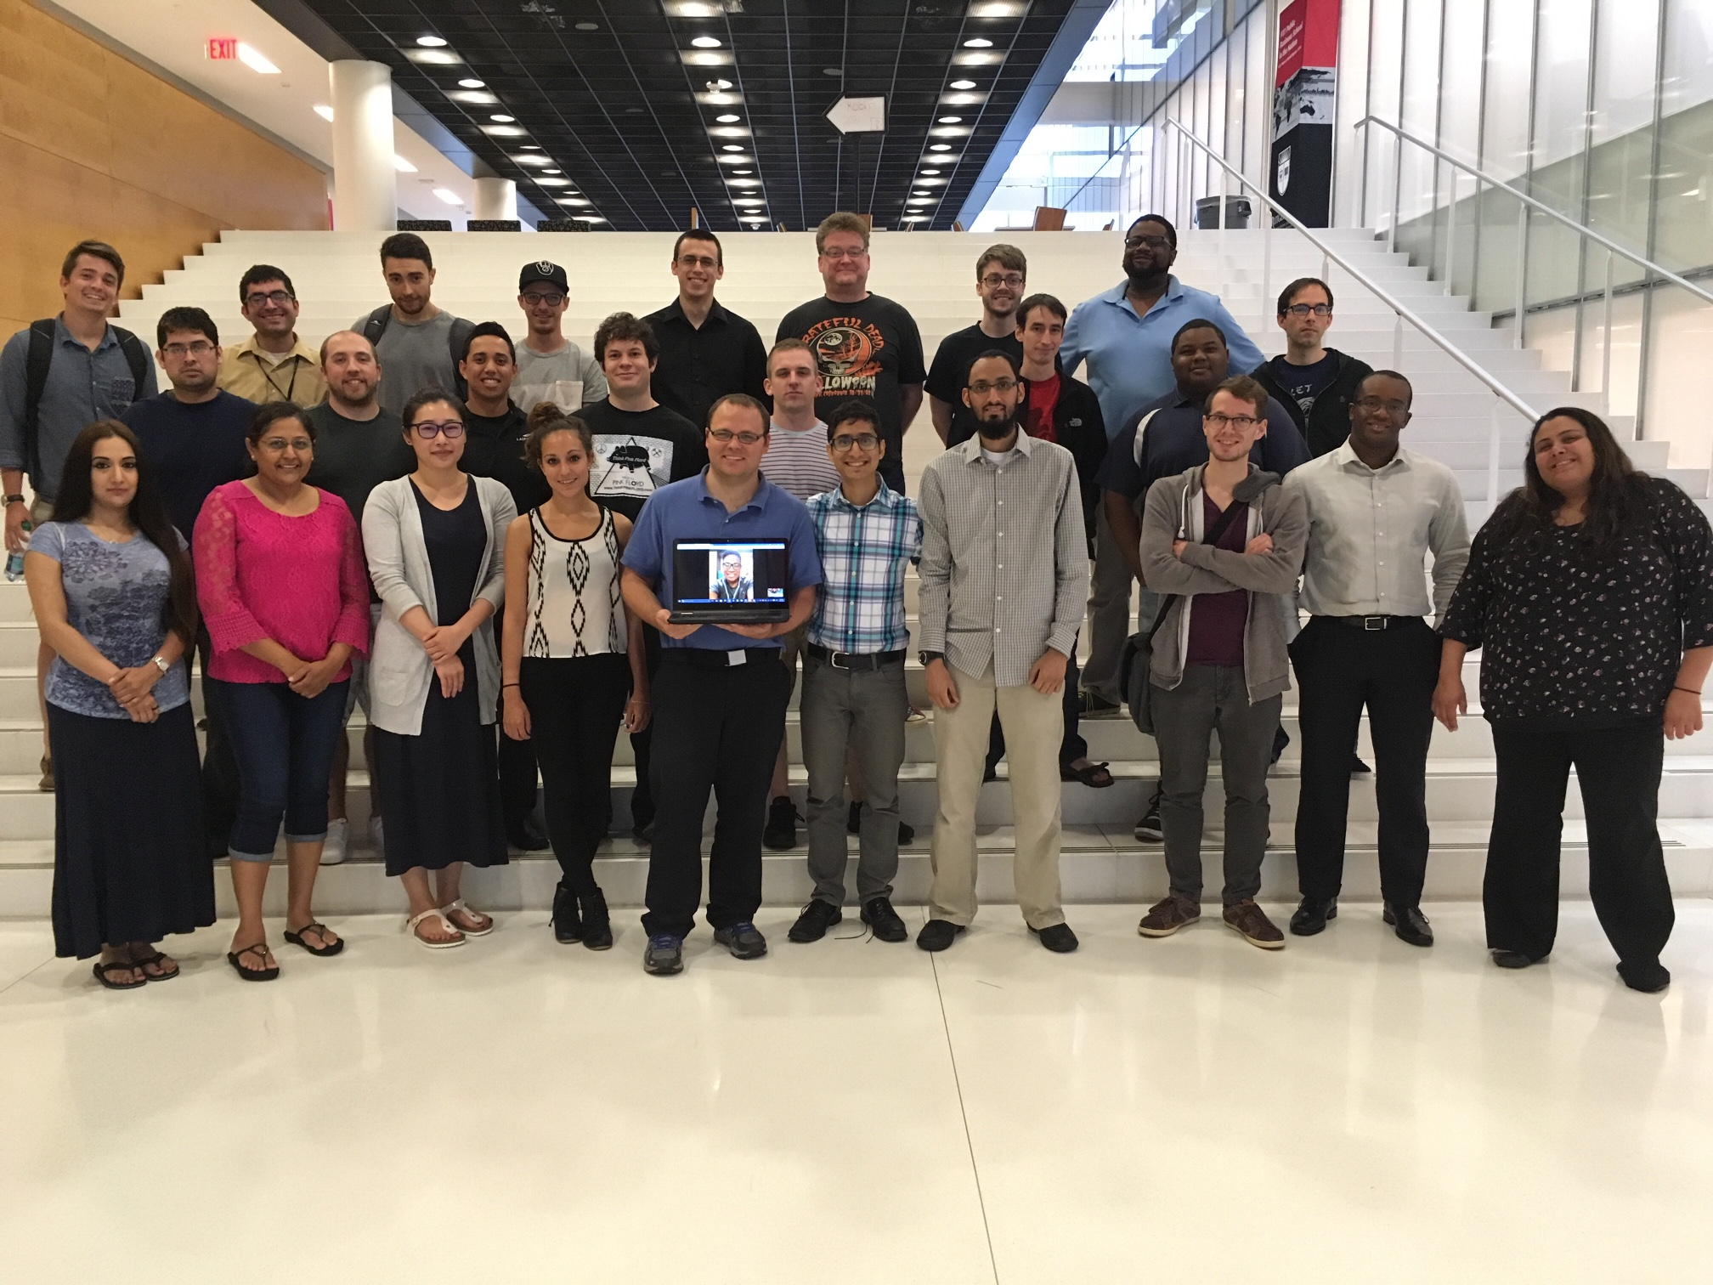
Outline

Slide 7
What Students (Really) Want…
Scenes from the Classroom

Slide 8
What Students (Really) Want…
Scenes from the Classroom

Slide 9
What Students (Really) Want…
Scenes from the Classroom

Slide 10
Class is Still the To Be
Scenes from the Classroom

Slide 11
So… What is data science?

Slide 12
First Thoughts…

Slide 13
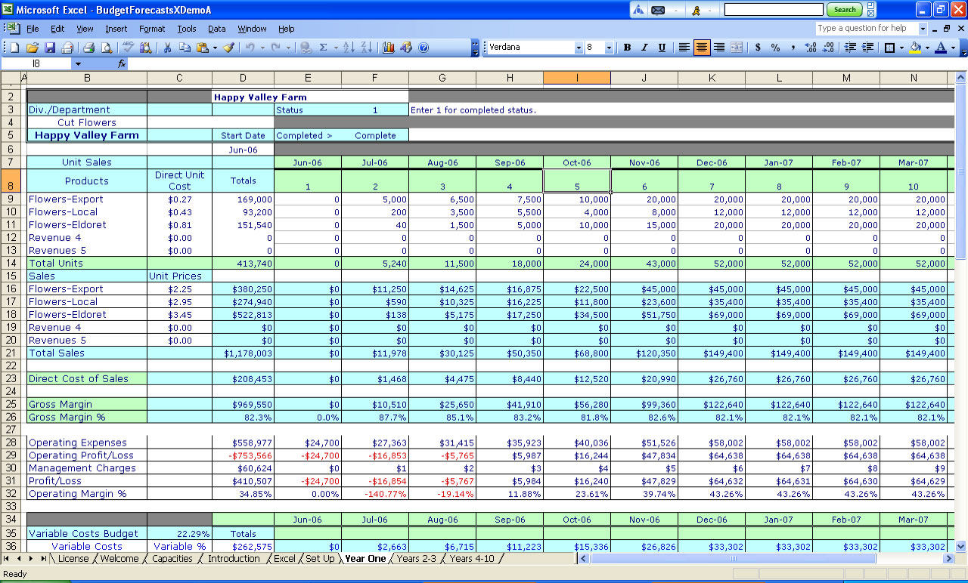
First Thoughts…

Slide 14

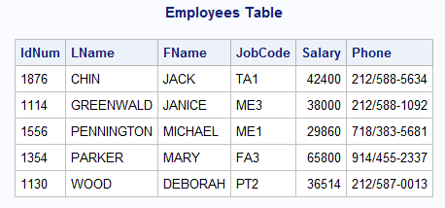
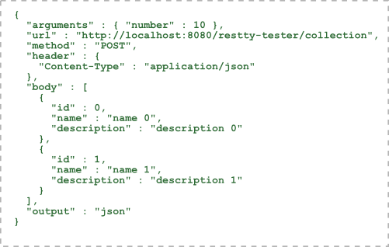

First Thoughts…

Slide 15
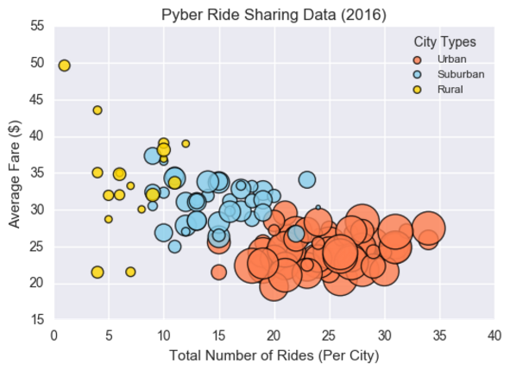
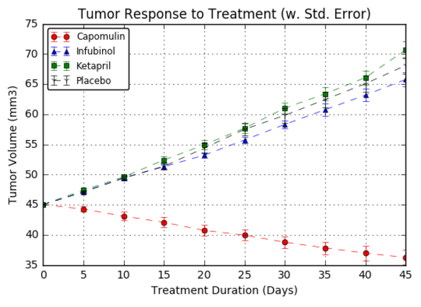

First Thoughts…

Slide 16
Data Science centers on two things:

Slide 17
Truth-Telling & Story Telling

Slide 18
Tools for Truths, Skills for Stories…
Our Goals
Truth-Telling
Story-Telling
Our Means
Microsoft Excel
Python
Pandas
Tweepy
VADER
Matplotlib / Seaborn
APIs
Beautiful Soup
Machine Learning
MySQL
MongoDB
HTML / CSS
JavaScript
D3.js
Leaflet.js / Google Maps
CartoDB
Tableau
Hadoop

Slide 19
Telling Stories With Data

Slide 20
Ask the Universe a Question…

Slide 21
And Find The Answer…

Slide 22
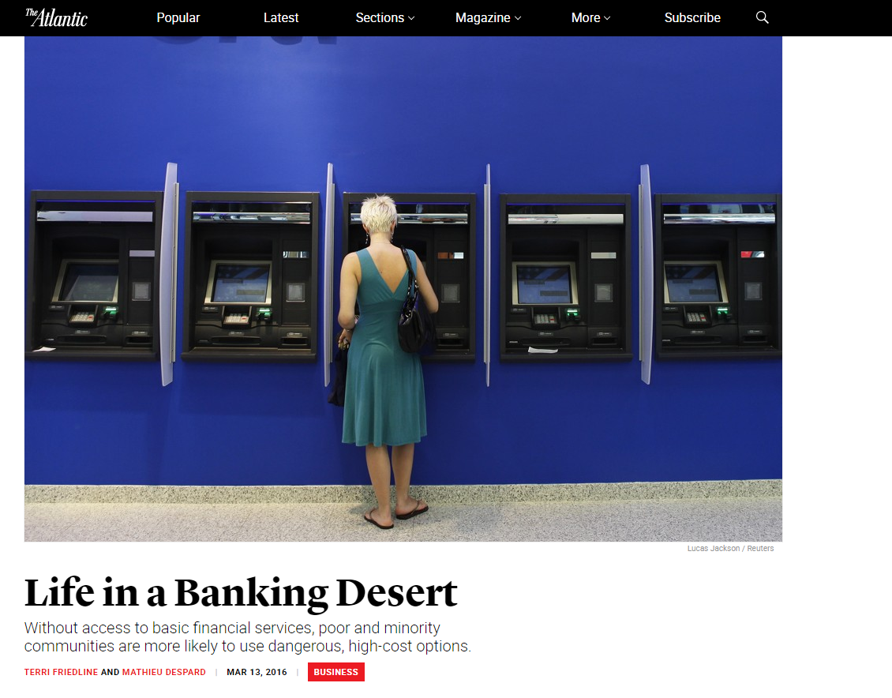
Finding Deserts in America

Slide 23
But How Would You Prove this?

Slide 24
Analytics Paradigm
Decompose the Ask
Identify Data Sources
Define Strategy and Metrics
Build Data Retrieval Plan
Retrieve the Data
Assemble and Clean
Analyze for Trends
Acknowledge Limitations
Make the Call or
Tell the Story
Regardless of type or industry, this paradigm provides a repeatable pathway for effective data problem solving.

Slide 25
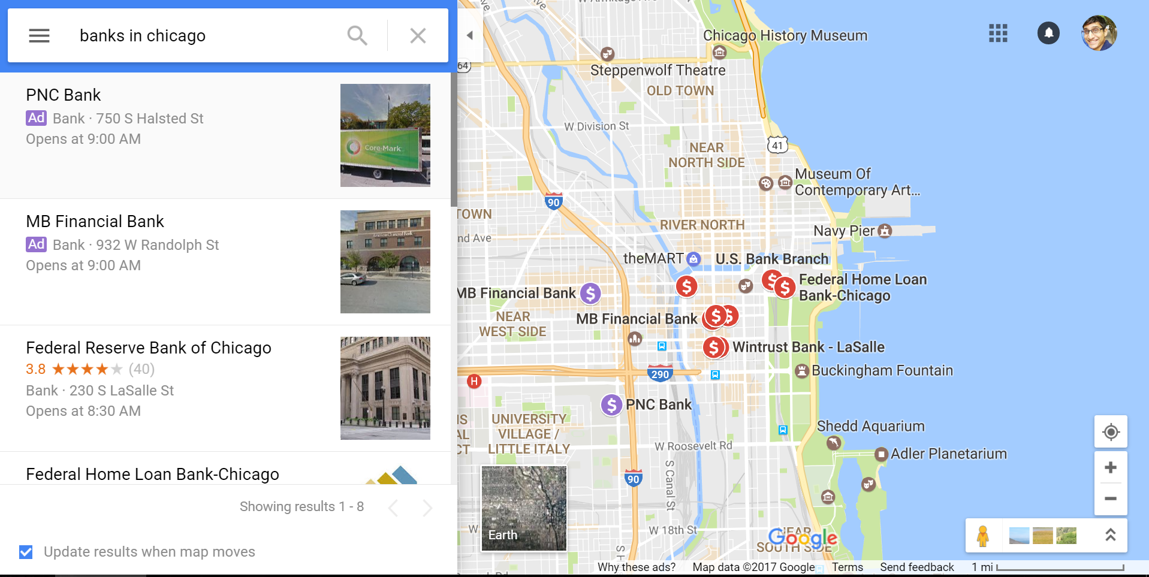

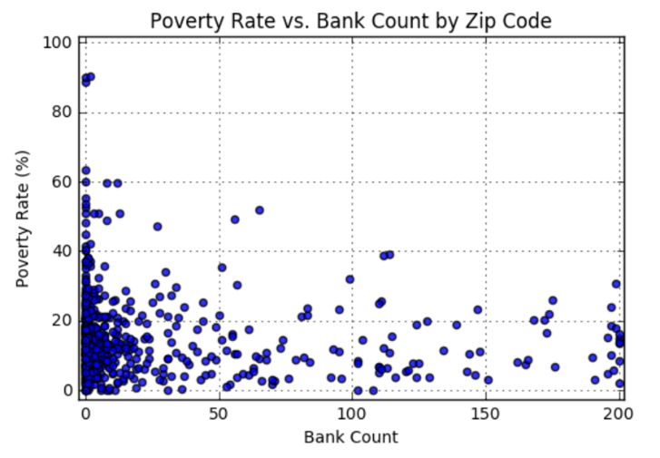
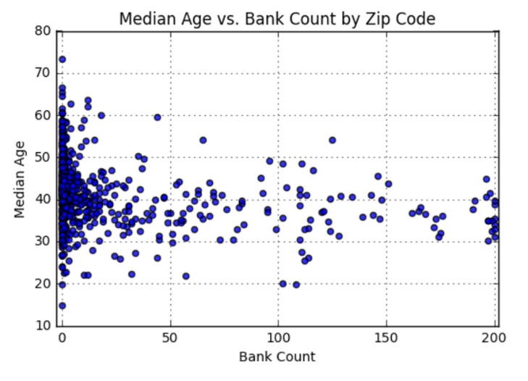
Finding Deserts in America
We’ll be utilizing data from sources like the US Census, Google Maps, and more to dredge out insights on poverty, discrimination, and the impact of changing economies.

Slide 26
Time to Code + Demo

Slide 27
Questions / Discussion

